Slide 1
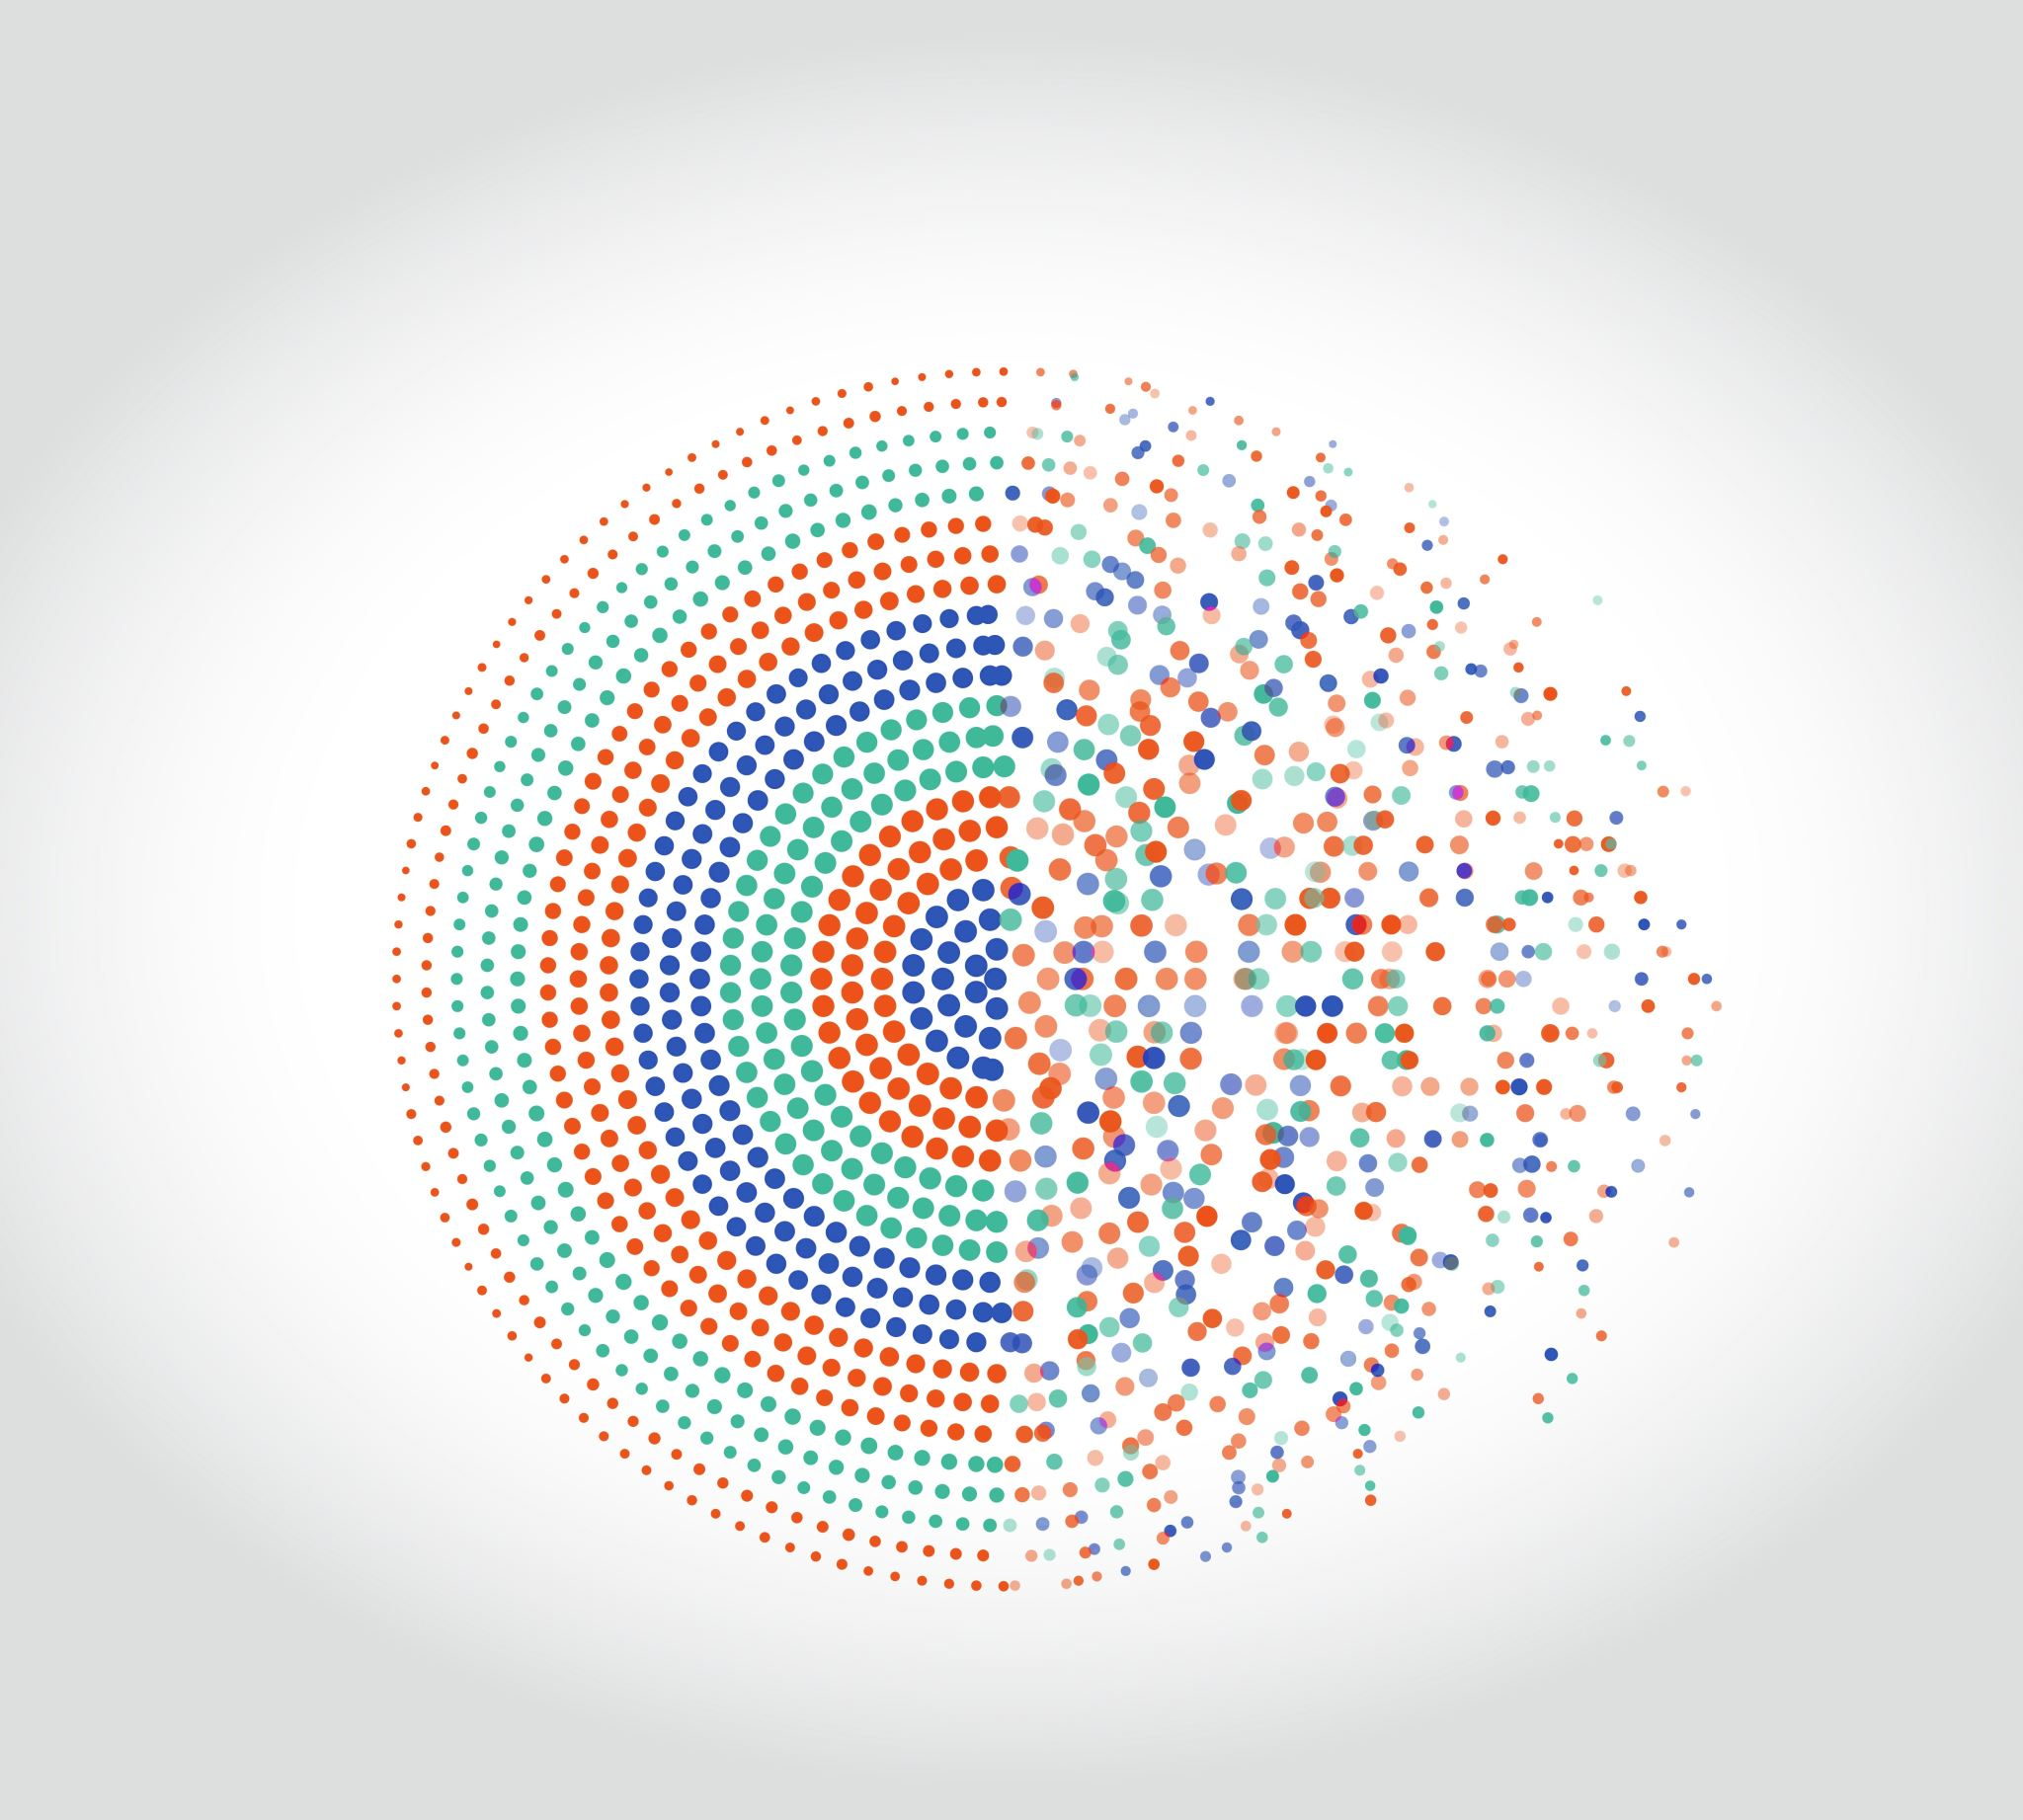
Evaluation Metrics

Slide 2
Topics
Imbalanced Datasets
Evaluation Metrics
Accuracy
Precision and Recall
F-measure (F1 score)
Balanced Accuracy
ROC Curve and AUC
Precision-Recall Curve
ROC and P-R Curves for Multiclass

Slide 3
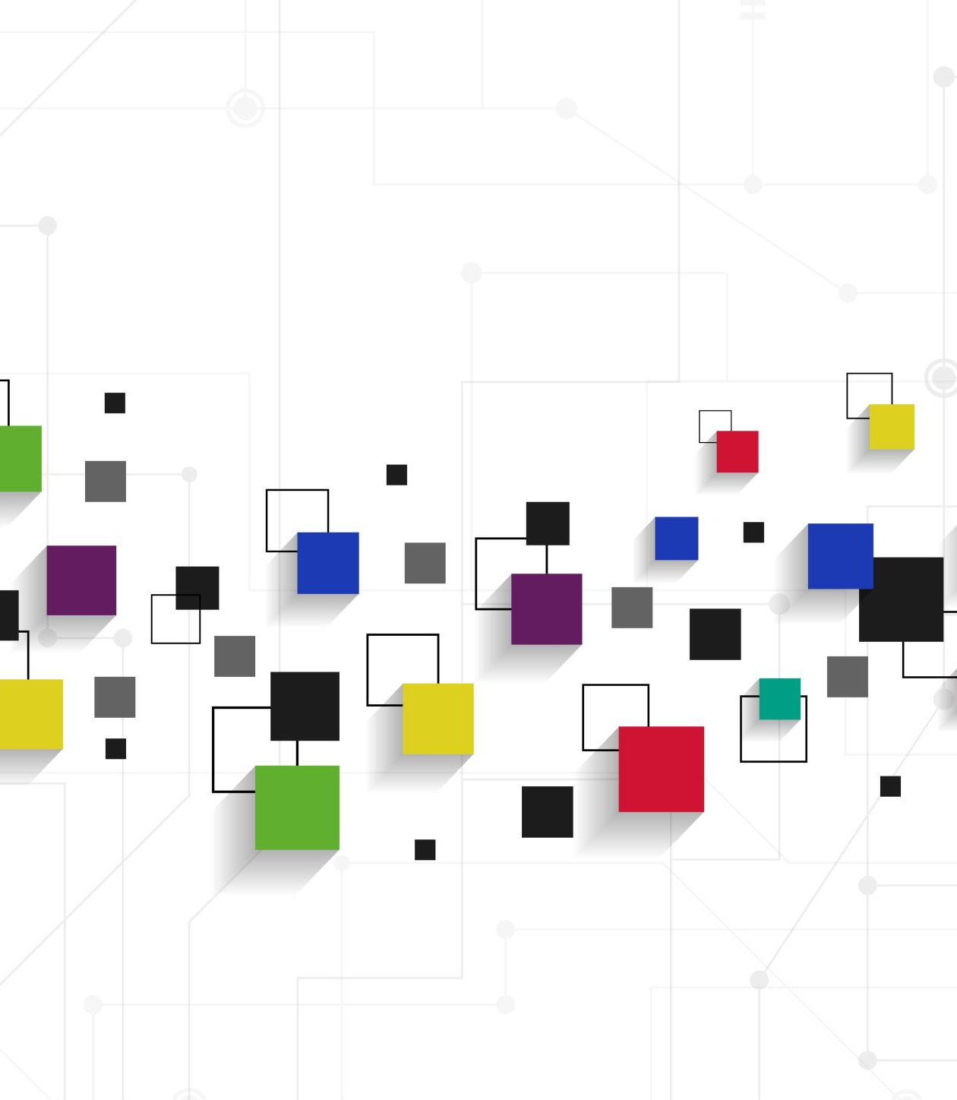
Imbalanced Datasets
Notes:
Pre-concepts: linearly separable classes, boundaries to classify classes

Slide 4
Imbalanced Dataset
Machine learning algorithms assume that our datasets have a balanced distribution
Same number of observations for all the classes that we have in the dataset
The problem with imbalanced datasets is that samples from the minority class are often misclassified
However, more often than not, we are particularly interested in predicting the minority class
Malware, fraud, medical diagnosis, network IDS, and so on

Slide 5
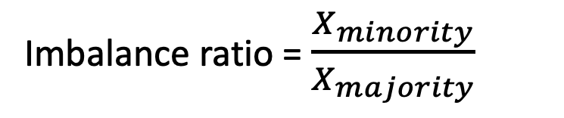
Imbalanced Dataset
In this example, we have 2 minority classes
The imbalance ratio is the ratio of the sample size of the minority class to that of the majority class
For example, 1/10 means that we have 1 observation from the minority per 10 observations of the majority
Imbalance ratio = $\frac{X_{minority}}{X_{majority}}$
Notes:
In the example, we have 4/17 and 3/17

Slide 6
Imbalanced Dataset
The fact that a dataset is imbalanced per se doesn't mean that it's going to be difficult to classify
The factors that influence the ability of a classifier to identify the rare events are in fact:
The size of the dataset
Class separability
Within-class sub-clusters

Slide 7
1. The size of the dataset
The size of the dataset affects the performance of a machine learning algorithm.
The bigger the dataset, the smaller the error that our machine learning models make.
And this is also true for imbalanced datasets.
A good thing? It depends!
If the sample size is limited, finding patterns inherent to the small class is hard
But as the data size increases, the error of the prediction may decrease.

Slide 8
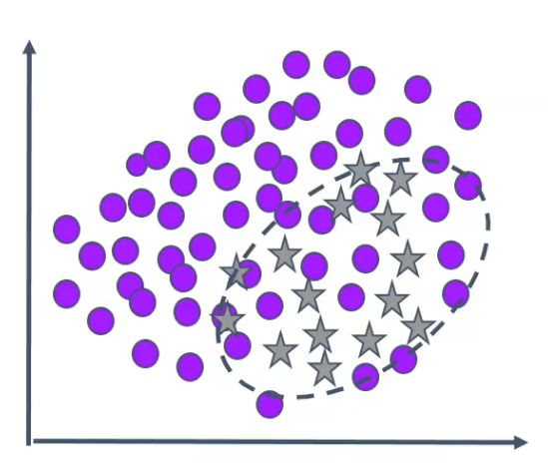
2. Class separability
Class separability defines how clearly different the observations from the different classes are
The more different they are, the easier they are to classify.
If patterns among the classes overlap, then it is harder for an algorithm to find rules or boundaries that separate one class from the other.
The real issue is not the “imbalance” but is the separability.
Notes:
For example, are linearly separable classes sensitive to imbalance?
No! No matter how much the imbalance is. Why?

Slide 9
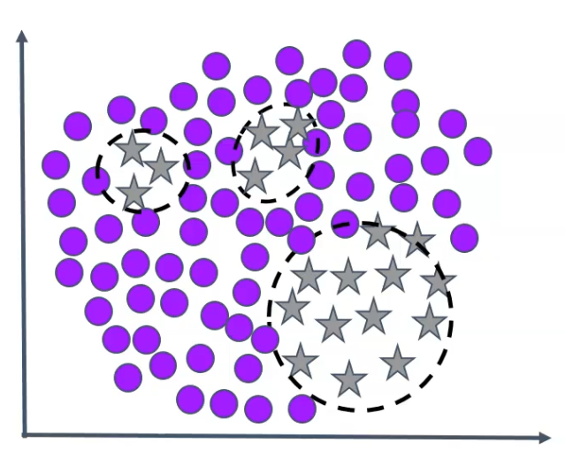
3. Within-class sub-clusters
In many classification problems, a single class is composed of various sub-clusters or concepts.
The class is not homogeneous, there are different components that make a class be a class.
These sub-clusters, in addition, may not always contain the same number of examples.
This phenomenon is referred to as within-class imbalance.
Notes:
The fact that there are sub-clusters within our class increases the complexity of our minority class and therefore makes it harder to find boundaries to separate the classes.

Slide 10
Imbalanced Dataset
For the model to learn well, we need:
Enough samples
That the classes are well separated
Absence of intra-class sub-clusters

Slide 11
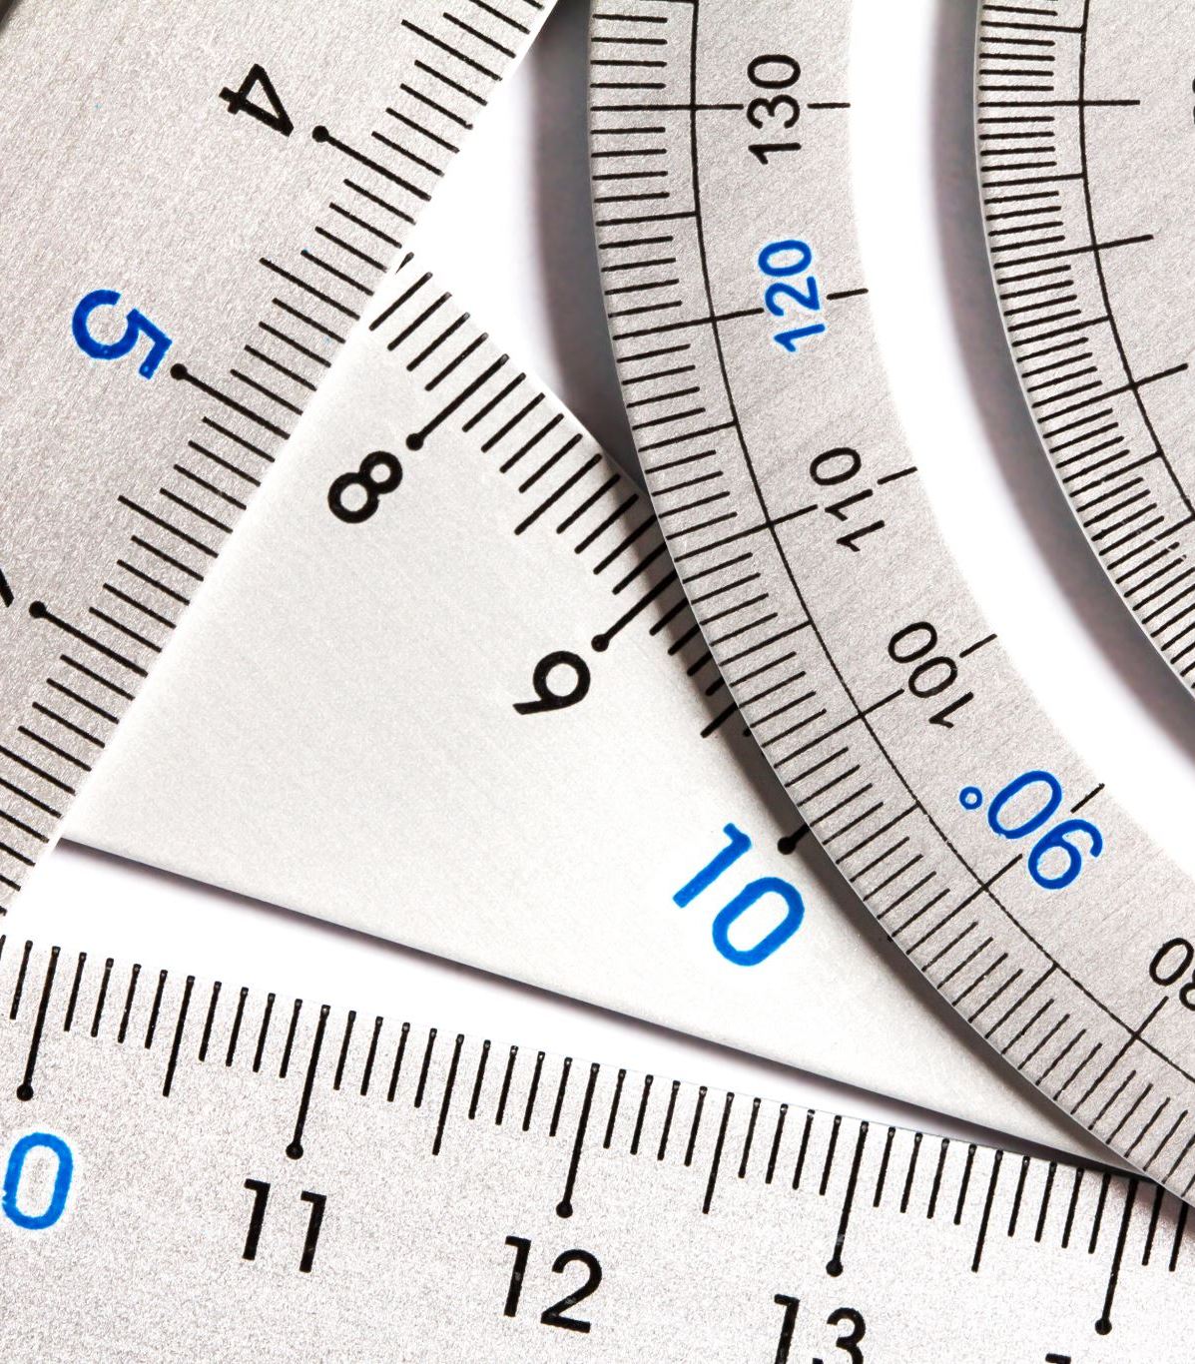
Evaluation Metrics

Slide 12
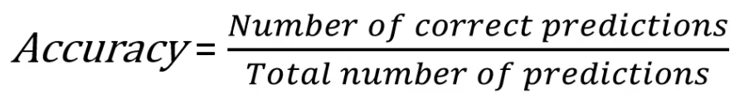
Accuracy
The accuracy represents the percentage or the fraction of correct predictions
That is, the fractions of the predictions that the model got right

Slide 13
Accuracy
For binary classification, we can remake this formula as:
The two formulas are actually the same. Why?
Notes:
The total number of true positives plus the total number of true negatives, divided by the total number of predictions.

Slide 14
Accuracy
However, for imbalanced datasets, the accuracy isn't an appropriate metric
It does not distinguish between the numbers of correctly classified examples of the different classes.
The minority class has very little impact on the overall accuracy value just because there are very few examples of this minority class.
Let’s see an example (next slide)

Slide 15
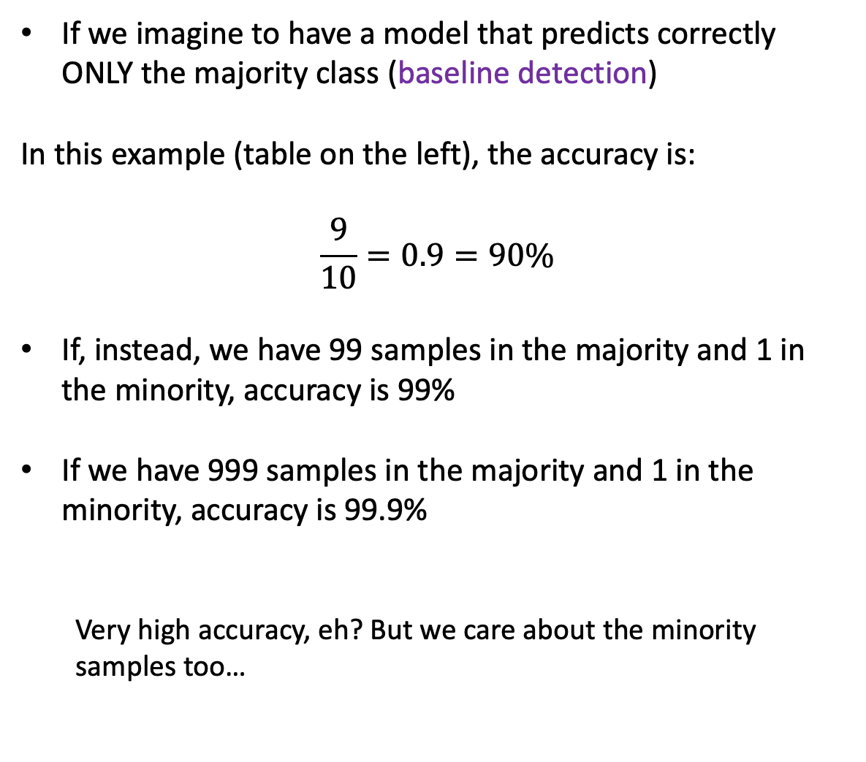
Accuracy
If we imagine to have a model that predicts correctly ONLY the majority class (baseline detection)
In this example (table on the left), the accuracy is:
$$\frac{9}{10}=0.9=90\%$$
If, instead, we have 99 samples in the majority and 1 in the minority, accuracy is 99%
If we have 999 samples in the majority and 1 in the minority, accuracy is 99.9%
Very high accuracy, eh? But we care about the minority samples too…
Target | Prediction
0 | 0
0 | 0
0 | 0
0 | 0
0 | 0
0 | 0
0 | 0
0 | 0
0 | 0
1 | 0

Slide 16
Accuracy
Target | Prediction
0 | 0
0 | 0
0 | 0
0 | 0
0 | 0
0 | 0
0 | 0
0 | 0
0 | 0
1 | 0
Accuracy will not let us know how good the minority class was classified
We need some other metrics better suited for unbalanced datasets:
Precision, Recall, and F-measure (F1 Score)
We want to maximize Precision and Recall

Slide 17
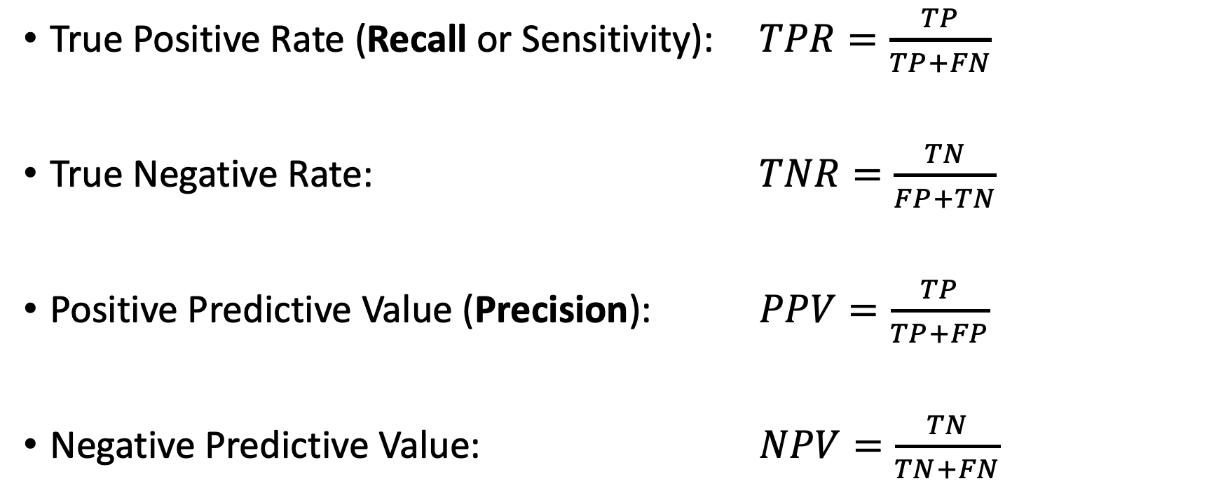
Precision and Recall
Minority Class
True Positive Rate (Recall or Sensitivity): $TPR=\frac{TP}{TP+FN}$
True Negative Rate: $TNR=\frac{TN}{FP+TN}$
Positive Predictive Value (Precision): $PPV=\frac{TP}{TP+FP}$
Negative Predictive Value: $NPV=\frac{TN}{TN+FN}$
Majority Class
Minority Class
Majority Class
Notes:
PPV is also known as Sensibility

Slide 18
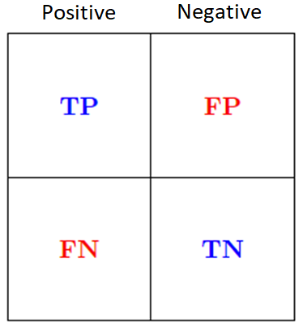
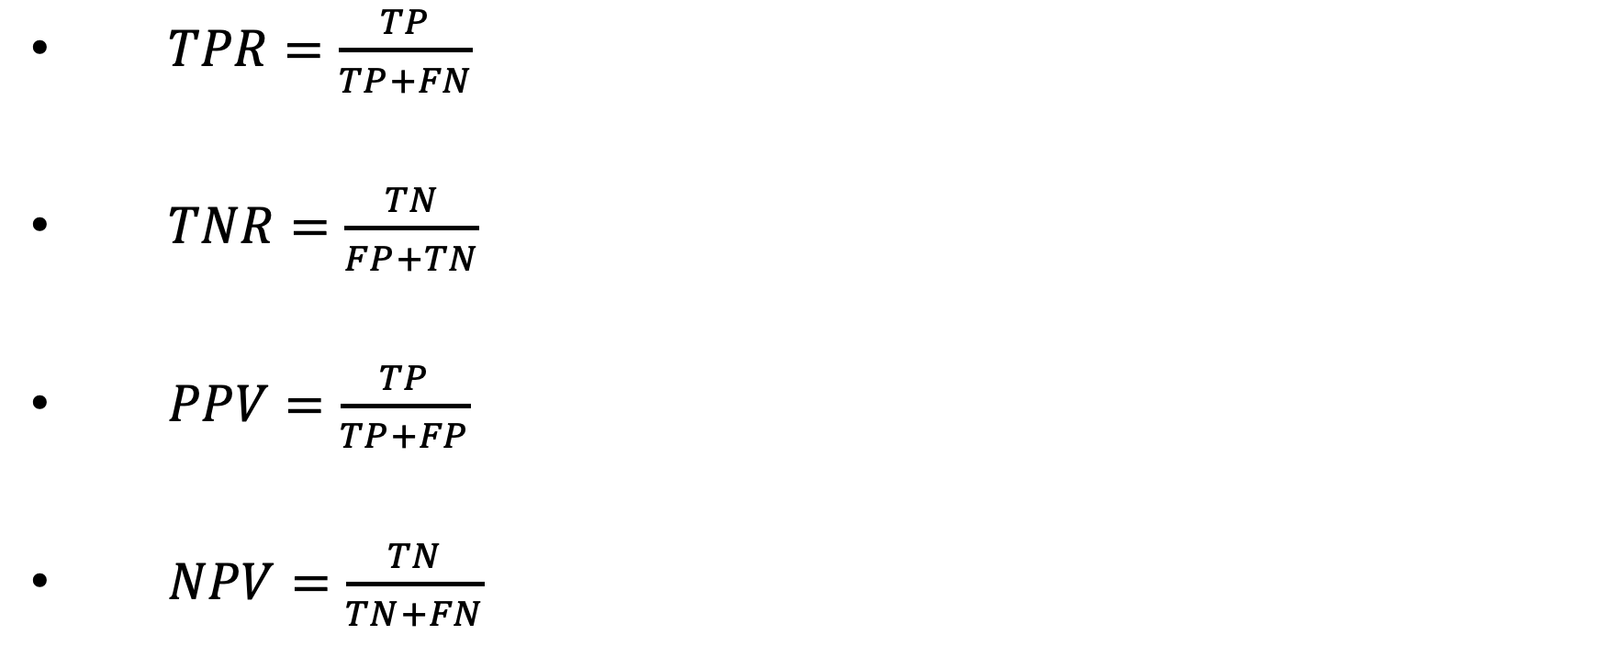
Precision and Recall
$TPR=\frac{TP}{TP+FN}$
$TNR=\frac{TN}{FP+TN}$
$PPV=\frac{TP}{TP+FP}$
$NPV=\frac{TN}{TN+FN}$
Classified as Positive
Classified as Negative
18
Notes:
Positive Predictive Value (Precision)
True Positive Rate (Recall or Sensitivity)

Slide 19
Precision and Recall
$TPR=\frac{TP}{TP+FN}$
$TNR=\frac{TN}{FP+TN}$
$PPV=\frac{TP}{TP+FP}$
$NPV=\frac{TN}{TN+FN}$
Classified as Positive
Classified as Negative
19
Notes:
Positive Predictive Value (Precision)
True Positive Rate (Recall or Sensitivity)

Slide 20
Precision and Recall
$TPR=\frac{TP}{TP+FN}$
$TNR=\frac{TN}{FP+TN}$
$PPV=\frac{TP}{TP+FP}$
$NPV=\frac{TN}{TN+FN}$
Classified as Positive
Classified as Negative
20
Notes:
Positive Predictive Value (Precision)
True Positive Rate (Recall or Sensitivity)

Slide 21
Precision and Recall
$TPR=\frac{TP}{TP+FN}$
$TNR=\frac{TN}{FP+TN}$
$PPV=\frac{TP}{TP+FP}$
$NPV=\frac{TN}{TN+FN}$
Classified as Positive
Classified as Negative
21
Notes:
Positive Predictive Value (Precision)
True Positive Rate (Recall or Sensitivity)

Slide 22
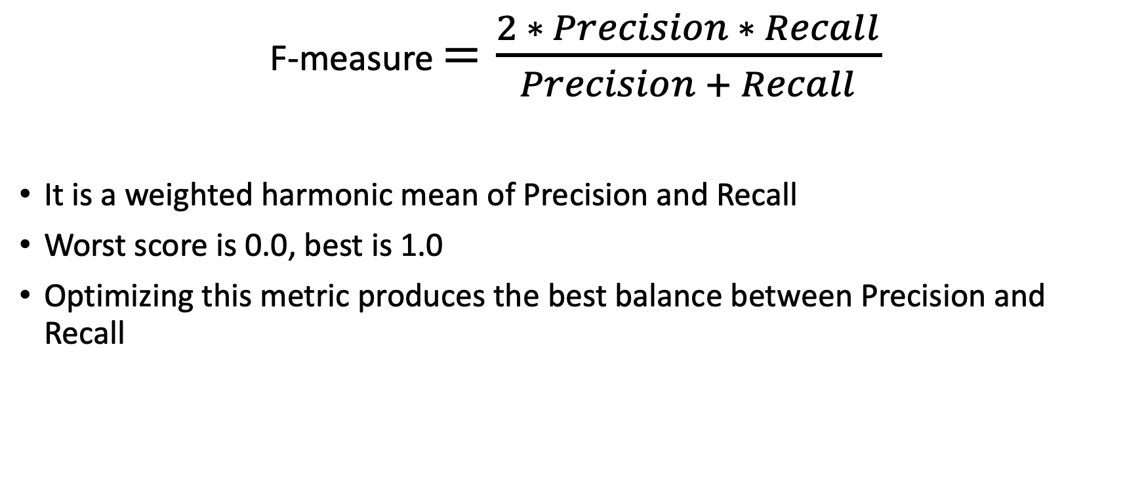
F-measure (F1 score)
F-measure $=\frac{2 ∗ Precision ∗ Recall}{Precision + Recall}$
It is a weighted harmonic mean of Precision and Recall
Worst score is 0.0, best is 1.0
Optimizing this metric produces the best balance between Precision and Recall

Slide 23
Support
Support is another key element when we determine the performance of the model
It refers to the number of actual occurrences of the class in the specified dataset
In other words, the number of examples for each one of the classes in our dataset
It's useful to keep the value of the Support in mind because it highlights if we have imbalanced datasets
Let's illustrate all these metrics with an example (next slides)...

Slide 24
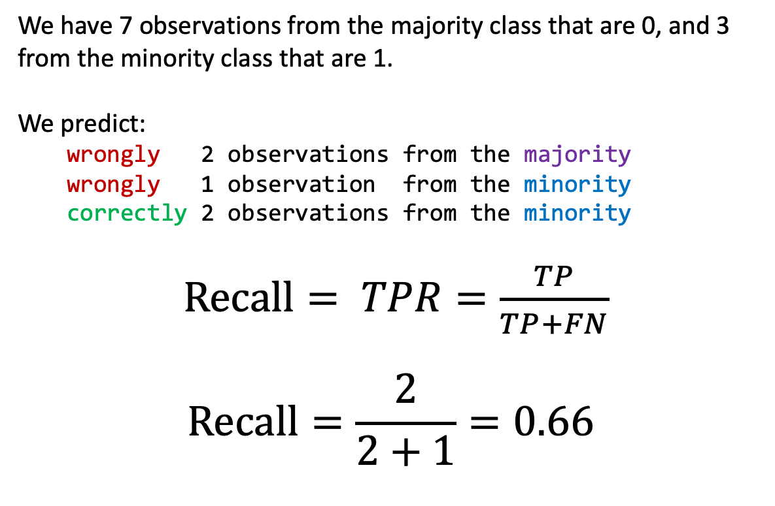
Recall example
Target | Prediction
0 | 0
0 | 0
0 | 0
0 | 1
0 | 1
0 | 0
0 | 0
1 | 0
1 | 1
1 | 1
We have 7 observations from the majority class that are 0, and 3 from the minority class that are 1.
We predict:
wrongly 2 observations from the majority
wrongly 1 observation from the minority
correctly 2 observations from the minority
$Recall= TPR=\frac{TP}{TP+FN}$
$$Recall=\frac{2}{2+1}=0.66$$
The Positive class is the minority class

Slide 25
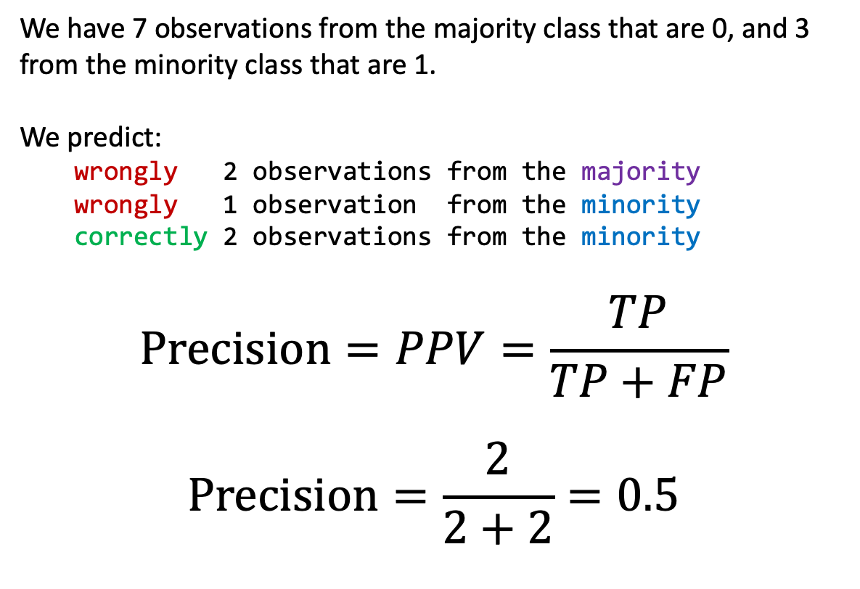
Precision example
Target | Prediction
0 | 0
0 | 0
0 | 0
0 | 1
0 | 1
0 | 0
0 | 0
1 | 0
1 | 1
1 | 1
We have 7 observations from the majority class that are 0, and 3 from the minority class that are 1.
We predict:
wrongly 2 observations from the majority
wrongly 1 observation from the minority
correctly 2 observations from the minority
$$Precision=PPV=\frac{TP}{TP+FP}$$
$$Precision=\frac{2}{2+2}=0.5$$

Slide 26
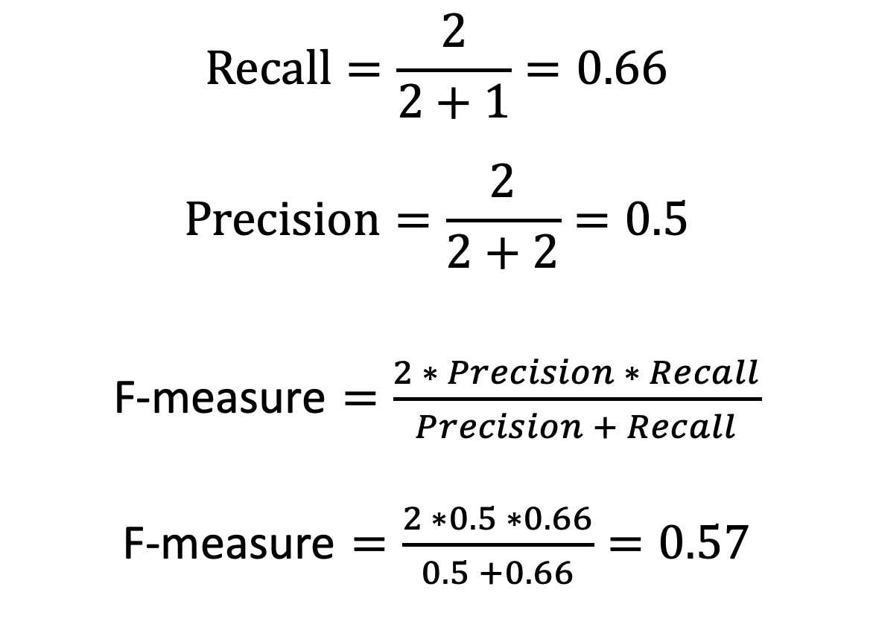
F-measure example
$$Recall=\frac{2}{2+1}=0.66$$
$$Precision=\frac{2}{2+2}=0.5$$
F-measure $=\frac{2 ∗ Precision ∗ Recall}{Precision + Recall}$
F-measure $=\frac{2 ∗0.5 ∗0.66}{0.5 +0.66}=0.57$
Target | Prediction
0 | 0
0 | 0
0 | 0
0 | 1
0 | 1
0 | 0
0 | 0
1 | 0
1 | 1
1 | 1
Notes:
In case you want to compute, the TNR is 0.71, and the NPV is 0.82

Slide 27
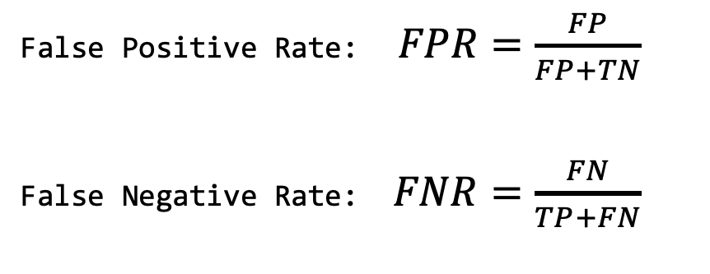
Classified as Positive
In the main diagonal we find the correctly identified observations.
The confusion matrix, False Positive Rate and False Negative Rate also depend on the probability threshold that we choose to select or to classify a sample as positive, and they vary depending on the threshold.
Classified as Negative
False Positive Rate: $FPR=\frac{FP}{FP+TN}$
False Negative Rate: $FNR=\frac{FN}{TP+FN}$
Notes:
Our goal is to minimize any of FPR and FNR, depending on what we are trying to predict.

Slide 28
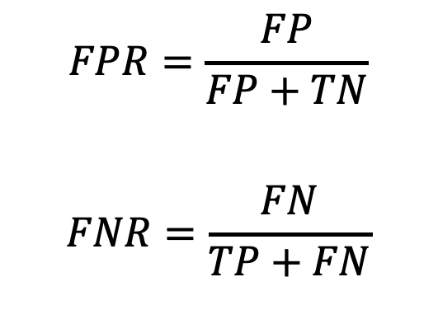
Classified as Positive
$$FPR=\frac{FP}{FP+TN}$$
$$FNR=\frac{FN}{TP+FN}$$
Classified as Negative
Which one to minimize?
For example, if we are doing disease diagnosis, we want to minimize the number of sick patients that we do not diagnose as sick, because we need to assign treatment as quickly as possible
Therefore, we don't really want to miss any case that is positive
In a situation like this, we may choose to optimize the False Negative Rate
Notes:
Our goal is to minimize any of FPR and FNR, depending on what we are trying to predict.

Slide 29
Classified as Positive
$$FPR=\frac{FP}{FP+TN}$$
$$FNR=\frac{FN}{TP+FN}$$
Classified as Negative
Which one to minimize?
If we are doing drug discovery, and we are trying to find from several drugs which one can treat a certain disease, we want to minimize the False Positive Rate.
That is, we want to minimize the number of drugs that we think could be beneficial, but in fact they are not.
Notes:
Our goal is to minimize any of FPR and FNR, depending on what we are trying to predict.

Slide 30
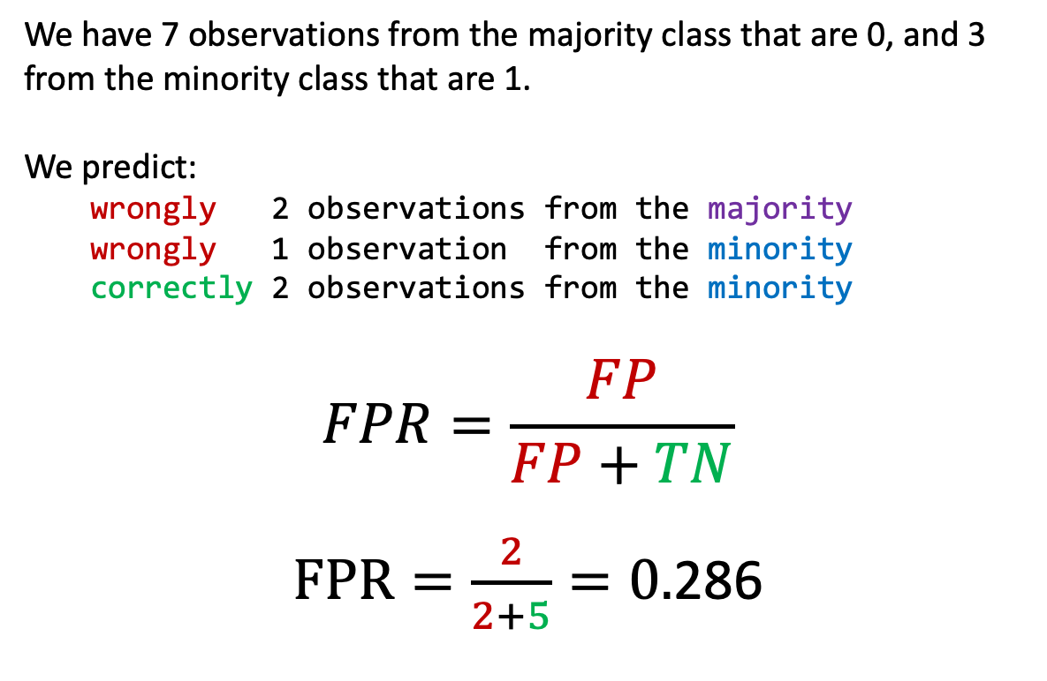
FPR example
Target | Prediction
0 | 0
0 | 0
0 | 0
0 | 1
0 | 1
0 | 0
0 | 0
1 | 0
1 | 1
1 | 1
We have 7 observations from the majority class that are 0, and 3 from the minority class that are 1.
We predict:
wrongly 2 observations from the majority
wrongly 1 observation from the minority
correctly 2 observations from the minority
$$FPR=\frac{FP}{FP+TN}$$
$FPR=\frac{2}{2+5}=0.$286

Slide 31
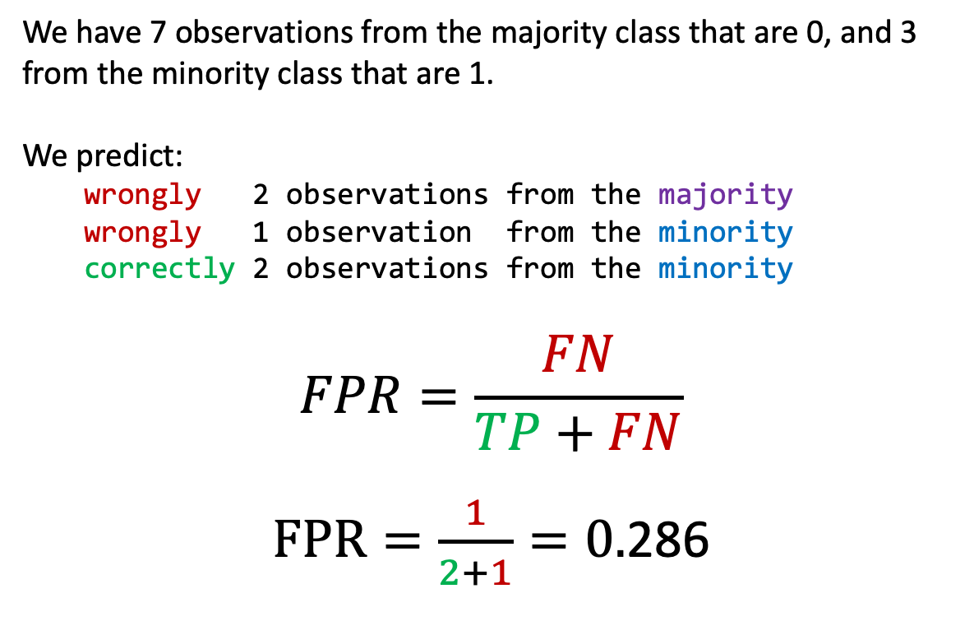
FNR example
Target | Prediction
0 | 0
0 | 0
0 | 0
0 | 1
0 | 1
0 | 0
0 | 0
1 | 0
1 | 1
1 | 1
We have 7 observations from the majority class that are 0, and 3 from the minority class that are 1.
We predict:
wrongly 2 observations from the majority
wrongly 1 observation from the minority
correctly 2 observations from the minority
$$FPR=\frac{FN}{TP+FN}$$
$FPR=\frac{1}{2+1}=0.$286

Slide 32
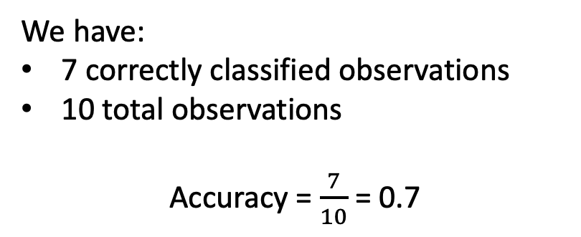
Balanced Accuracy
We have:
7 correctly classified observations
10 total observations
Accuracy = $\frac{7}{10}$ = 0.7
 | Positive | Negative
Classified Positive | 1 (TP) | 1 (FP)
Classified Negative | 2 (FN) | 6 (TN)
However, we see from this matrix that the model does a better job at classifying observations from the negative class than from the positive class
Basically, from 3 observations that belong to the minority class, only 1 is classified correctly.

Slide 33
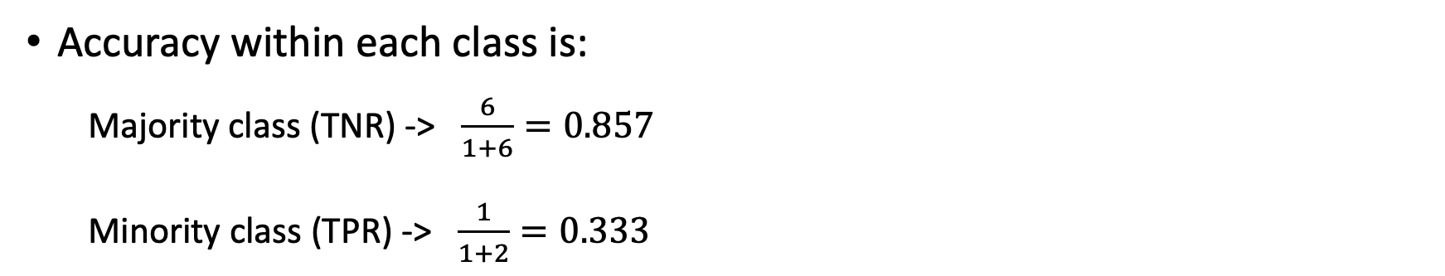
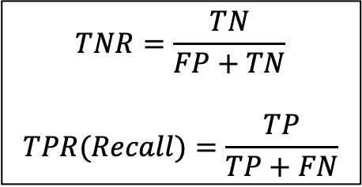
Balanced Accuracy
We have:
7 correctly classified observations
10 total observations
Accuracy = $\frac{7}{10}$ = 0.7
 | Positive | Negative
Classified Positive | 1 (TP) | 1 (FP)
Classified Negative | 2 (FN) | 6 (TN)
Accuracy within each class is:
Majority class (TNR) -> $\frac{6}{1+6}=0.857$
Minority class (TPR) -> $\frac{1}{1+2}=0.333$
$$TNR=\frac{TN}{FP+TN}$$
$$TPR(Recall)=\frac{TP}{TP+FN}$$

Slide 34
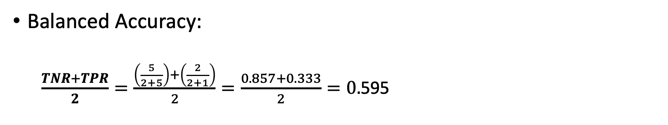
Balanced Accuracy
We have:
7 correctly classified observations
10 total observations
Accuracy = $\frac{7}{10}$ = 0.7
 | Positive | Negative
Classified Positive | 2 (TP) | 2 (FP)
Classified Negative | 1 (FN) | 5 (TN)
Balanced Accuracy:
$\frac{TNR+TPR}{2}=\frac{\left(\frac{5}{2+5}\right)+\left(\frac{2}{2+1}\right)}{2}=\frac{0.857+0.333}{2}=0.$595
$$TNR=\frac{TN}{FP+TN}$$
$$TPR(Recall)=\frac{TP}{TP+FN}$$

Slide 35
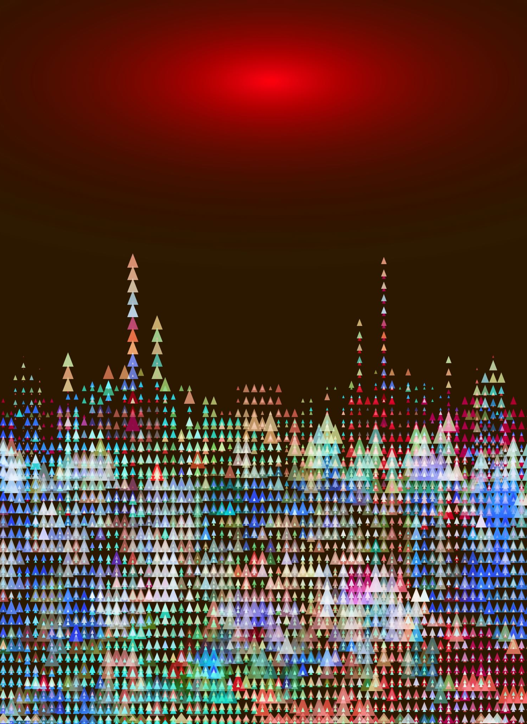
ROC Curve and AUC

Slide 36
ROC Curve
1
TPR
Suppose threshold set at yellow line
Above yellow, classified as positive,
Below yellow is negative
TPR = 1.0
TNR = 0.0
FPR = 1.0 – TNR = 1.0 – 0.0 = 1.0
0
1
FPR
score
test case

Slide 37
ROC Curve
1
TPR
Suppose threshold set at yellow line
Above yellow, classified as positive,
Below yellow is negative
TPR = 1.0
TNR = 0.2
FPR = 1.0 – TNR = 1.0 – 0.2 = 0.8
0
1
FPR
score
test case

Slide 38
ROC Curve
1
TPR
Suppose threshold set at yellow line
Above yellow, classified as positive,
Below yellow is negative
TPR = 1.0
TNR = 0.4
FPR = 1.0 – TNR = 1.0 – 0.4 = 0.6
0
1
FPR
score
test case

Slide 39
ROC Curve
1
TPR
Suppose threshold set at yellow line
Above yellow, classified as positive,
Below yellow is negative
TPR = 1.0
TNR = 0.6
FPR = 1.0 – TNR = 1.0 – 0.6 = 0.4
0
1
FPR
score
test case

Slide 40
ROC Curve
1
TPR
Suppose threshold set at yellow line
Above yellow, classified as positive,
Below yellow is negative
TPR = 0.8
TNR = 0.6
FPR = 1.0 – TNR = 1.0 – 0.6 = 0.4
0
1
FPR
score

Slide 41
ROC Curve
1
TPR
Suppose threshold set at yellow line
Above yellow, classified as positive,
Below yellow is negative
TPR = 0.6
TNR = 0.6
FPR = 1.0 – TNR = 1.0 – 0.6 = 0.4
0
1
FPR
score

Slide 42
ROC Curve
1
TPR
Suppose threshold set at yellow line
Above yellow, classified as positive,
Below yellow is negative
TPR = 0.6
TNR = 0.8
FPR = 1.0 – TNR = 1.0 – 0.8 = 0.2
0
1
FPR
score

Slide 43
ROC Curve
1
TPR
Suppose threshold set at yellow line
Above yellow, classified as positive,
Below yellow is negative
TPR = 0.4
TNR = 0.8
FPR = 1.0 – TNR = 1.0 – 0.8 = 0.2
0
1
FPR
score

Slide 44
ROC Curve
1
TPR
Suppose threshold set at yellow line
Above yellow, classified as positive,
Below yellow is negative
TPR = 0.4
TNR = 1.0
FPR = 1.0 – TNR = 1.0 – 1.0 = 0.0
0
1
FPR
score

Slide 45
ROC Curve
1
TPR
Suppose threshold set at yellow line
Above yellow, classified as positive,
Below yellow is negative
TPR = 0.2
TNR = 1.0
FPR = 1.0 – TNR = 1.0 – 0.6 = 0.0
0
1
FPR
score

Slide 46
ROC Curve
1
TPR
Suppose threshold set at yellow line
Above yellow, classified as positive,
Below yellow is negative
TPR = 0.0
TNR = 1.0
FPR = 1.0 – TNR = 1.0 – 0.6 = 0.0
0
1
FPR
score

Slide 47
ROC Curve
Random classifier?
Orange 45 degree line
Perfect classifier?
Red (Why?)
Above 45 degree line?
Better than random
The closer to the red, the closer to ideal
1
TPR
0
1
FPR

Slide 48
Area Under the Curve (AUC)
ROC curve lives within a 1x1 square
Random classifier?
AUC ≈ 0.5
Perfect classifier (red)?
AUC = 1.0
Example curve (blue)?
AUC = 0.8
1
TPR
0
1
FPR
Notes:
In general, the area under the ROC curve (AUC) is equal to the probability that the classifier will rank a randomly chosen positive instance higher than a randomly chosen negative one (for more details, see the paper by Bradley referenced at the end of the slides).

Slide 49
Area Under the Curve (AUC)
Area under ROC curve quantifies success
0.5 ⎯ like flipping coin
1.0 ⎯ ideal detection
AUC of ROC curve
Enables us to compare different techniques
And no need to worry about threshold
1
TPR
0
1
FPR
Notes:
Of course, this doesn’t solve every possible problem… For example, the results still depend on the selection of match and nomatch sets. So, if we choose an unrealistically easy nomatch set, then the ROC results might look good, but the score could still fail miserably in practice.

Slide 50

Precision-Recall Curve

Slide 51
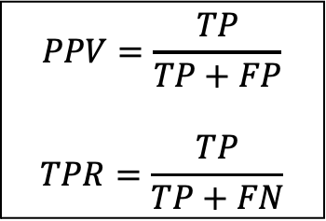
Precision-Recall Curve
1
Precision(PPV)
Suppose threshold set at yellow line
Above yellow, classified as positive
Below yellow is negative
PPV = 1.0
TPR = 1.0
0
1
Recall(TPR)
score
$$PPV=\frac{TP}{TP+FP}$$
$$TPR=\frac{TP}{TP+FN}$$
test case
Notes:
PPV is still the Positive Predictive Value (Precision)
TPR is Recall

Slide 52
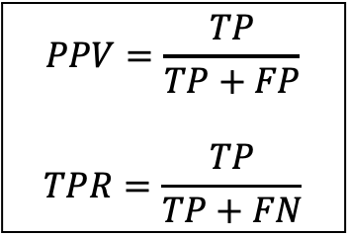
Precision-Recall Curve
1
Precision(PPV)
Suppose threshold set at yellow line
Above yellow, classified as positive
Below yellow is negative
PPV = 5/10 = 0.5
TPR = 5/5 = 1.0
0
1
Recall(TPR)
$$PPV=\frac{TP}{TP+FP}$$
$$TPR=\frac{TP}{TP+FN}$$
score
 | Actual Positive | Actual Negative
Predicted Positive | 5 (TP) | 5 (FP)
Predicted Negative | 0 (FN) | 0 (TN)
test case

Slide 53
Precision-Recall Curve
1
Precision(PPV)
Suppose threshold set at yellow line
Above yellow, classified as positive
Below yellow is negative
PPV = 5/9 = 0.55
TPR = 5/5 = 1.0
0
1
Recall(TPR)
$$PPV=\frac{TP}{TP+FP}$$
$$TPR=\frac{TP}{TP+FN}$$
score
 | Actual Positive | Actual Negative
Predicted Positive | 5 (TP) | 4 (FP)
Predicted Negative | 0 (FN) | 1 (TN)
test case

Slide 54
Precision-Recall Curve
1
Precision(PPV)
Suppose threshold set at yellow line
Above yellow, classified as positive
Below yellow is negative
PPV = 5/8 = 0.625
TPR = 5/5 = 1.0
0
1
Recall(TPR)
$$PPV=\frac{TP}{TP+FP}$$
$$TPR=\frac{TP}{TP+FN}$$
score
 | Actual Positive | Actual Negative
Predicted Positive | 5 (TP) | 3 (FP)
Predicted Negative | 0 (FN) | 2 (TN)
test case

Slide 55
Precision-Recall Curve
1
Precision(PPV)
Suppose threshold set at yellow line
Above yellow, classified as positive
Below yellow is negative
PPV = 5/7 = 0.71
TPR = 5/5 = 1.0
0
1
Recall(TPR)
$$PPV=\frac{TP}{TP+FP}$$
$$TPR=\frac{TP}{TP+FN}$$
score
 | Actual Positive | Actual Negative
Predicted Positive | 5 (TP) | 2 (FP)
Predicted Negative | 0 (FN) | 3 (TN)
test case

Slide 56
Precision-Recall Curve
1
Precision(PPV)
Suppose threshold set at yellow line
Above yellow, classified as positive
Below yellow is negative
PPV = 4/6 = 0.66
TPR = 4/5 = 0.8
0
1
Recall(TPR)
$$PPV=\frac{TP}{TP+FP}$$
$$TPR=\frac{TP}{TP+FN}$$
score
 | Actual Positive | Actual Negative
Predicted Positive | 4 (TP) | 2 (FP)
Predicted Negative | 1 (FN) | 3 (TN)
test case

Slide 57
Precision-Recall Curve
1
Precision(PPV)
Suppose threshold set at yellow line
Above yellow, classified as positive
Below yellow is negative
PPV = 3/5 = 0.6
TPR = 3/5 = 0.6
0
1
Recall(TPR)
$$PPV=\frac{TP}{TP+FP}$$
$$TPR=\frac{TP}{TP+FN}$$
score
 | Actual Positive | Actual Negative
Predicted Positive | 3 (TP) | 2 (FP)
Predicted Negative | 2 (FN) | 3 (TN)
test case

Slide 58
Precision-Recall Curve
1
Precision(PPV)
Suppose threshold set at yellow line
Above yellow, classified as positive
Below yellow is negative
PPV = 3/4 = 0.75
TPR = 3/5 = 0.6
0
1
Recall(TPR)
$$PPV=\frac{TP}{TP+FP}$$
$$TPR=\frac{TP}{TP+FN}$$
score
 | Actual Positive | Actual Negative
Predicted Positive | 3 (TP) | 1 (FP)
Predicted Negative | 2 (FN) | 4 (TN)
test case

Slide 59
Precision-Recall Curve
1
Precision(PPV)
Suppose threshold set at yellow line
Above yellow, classified as positive
Below yellow is negative
PPV = 2/3 = 0.66
TPR = 2/5 = 0.4
0
1
Recall(TPR)
$$PPV=\frac{TP}{TP+FP}$$
$$TPR=\frac{TP}{TP+FN}$$
score
 | Actual Positive | Actual Negative
Predicted Positive | 2 (TP) | 1 (FP)
Predicted Negative | 3 (FN) | 4 (TN)
test case

Slide 60
Precision-Recall Curve
1
Precision(PPV)
Suppose threshold set at yellow line
Above yellow, classified as positive
Below yellow is negative
PPV = 2/2 = 1.0
TPR = 2/5 = 0.4
0
1
Recall(TPR)
$$PPV=\frac{TP}{TP+FP}$$
$$TPR=\frac{TP}{TP+FN}$$
score
 | Actual Positive | Actual Negative
Predicted Positive | 2 (TP) | 0 (FP)
Predicted Negative | 3 (FN) | 5 (TN)
test case

Slide 61
Precision-Recall Curve
1
Precision(PPV)
Suppose threshold set at yellow line
Above yellow, classified as positive
Below yellow is negative
PPV = 1/1 = 1.0
TPR = 1/5 = 0.2
0
1
Recall(TPR)
$$PPV=\frac{TP}{TP+FP}$$
$$TPR=\frac{TP}{TP+FN}$$
score
 | Actual Positive | Actual Negative
Predicted Positive | 1 (TP) | 0 (FP)
Predicted Negative | 4 (FN) | 5 (TN)
test case

Slide 62
Precision-Recall Curve
1
Precision(PPV)
Suppose threshold set at yellow line
Above yellow, classified as positive
Below yellow is negative
PPV = 0/0 = 1.0
TPR = 0/5 = 0.0
0
1
Recall(TPR)
$$PPV=\frac{TP}{TP+FP}$$
$$TPR=\frac{TP}{TP+FN}$$
score
 | Actual Positive | Actual Negative
Predicted Positive | 0 (TP) | 0 (FP)
Predicted Negative | 5 (FN) | 5 (TN)
test case

Slide 63
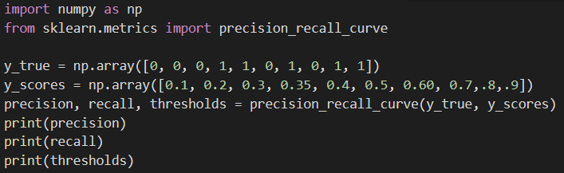
Precision-Recall Curve
1
Precision(PPV)
0
1
Recall(TPR)
score
 | Actual Positive | Actual Negative
Predicted Positive | 0 (TP) | 0 (FP)
Predicted Negative | 5 (FN) | 5 (TN)
test case

Slide 64
Precision-Recall Curve
The Precision-Recall Curves are robust to data imbalance
They may offer a better or a more visual indicator of model performance and allow us to easily see how one model is better than the other.
In the next two slides we see an example of this…

Slide 65
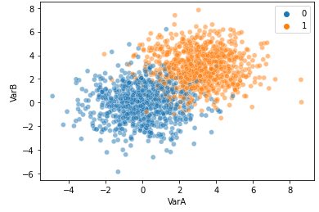
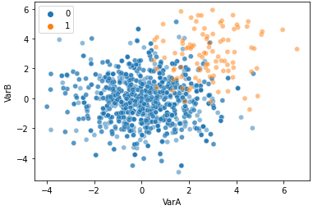
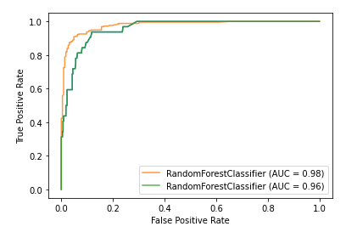
P-R Curve vs ROC Curve
Balanced dataset
ROC Curve
Imbalanced dataset

Slide 66
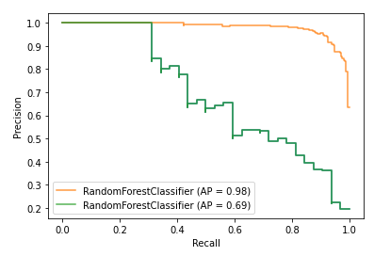
P-R Curve vs ROC Curve
Balanced dataset
P-R Curve
Imbalanced dataset

Slide 67
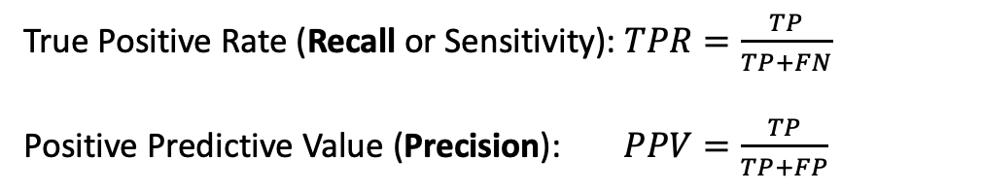
Precision-Recall Multiclass example
 | Class 0 | Class 1 | Class 2 | Class 3
Predicted 0 | 5 | 1 | 1 | 1
Predicted 1 | 0 | 4 | 1 | 2
Predicted 2 | 0 | 1 | 2 | 0
Predicted 3 | 1 | 0 | 0 | 1
True Positive Rate (Recall or Sensitivity): $TPR=\frac{TP}{TP+FN}$
Positive Predictive Value (Precision): $PPV=\frac{TP}{TP+FP}$
Recall:
Class 0 = 5 / (5 + 1 + 1 + 1) = 0.625
Class 1 = 4 / (0 + 4 + 1 + 2) = 0.571
Class 2 = 2 / (0 + 1 + 2 + 1) = 0.667
Class 3 = 1 / (1 + 0 + 0 + 1) = 0.5
Precision:
Class 0 = 5 / (5 + 0 + 0 + 1) = 0.833
Class 1 = 4 / (1 + 4 + 1 + 0) = 0.667
Class 2 = 2 / (1 + 1 + 2 + 0) = 0.5
Class 3 = 1 / (1 + 2 + 0 + 1) = 0.25
Notes:
Recall is by row, Precision is by column

Slide 68
ROC and P-R Curves for Multiclass
How do we extend the use of these metrics to multiclass problems?
We need to train our classifiers in a One-vs-Rest strategy
Class 0 vs Rest [Class 1 and 2]
Class 1 vs Rest [Class 0 and 2]
Class 2 vs Rest [Class 0 and 1]
In a One-vs-Rest strategy, we train one machine learning model per class
For each one of these binary classifications, we determine a ROC-curve or a PR curve

Slide 69
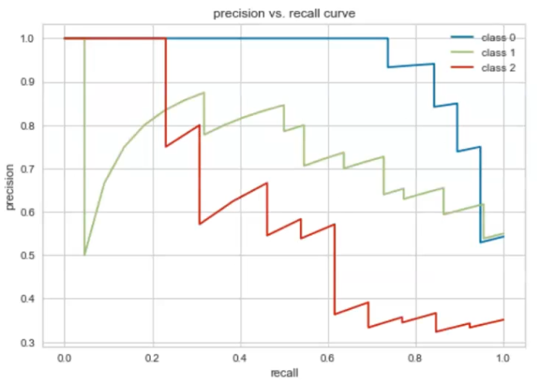
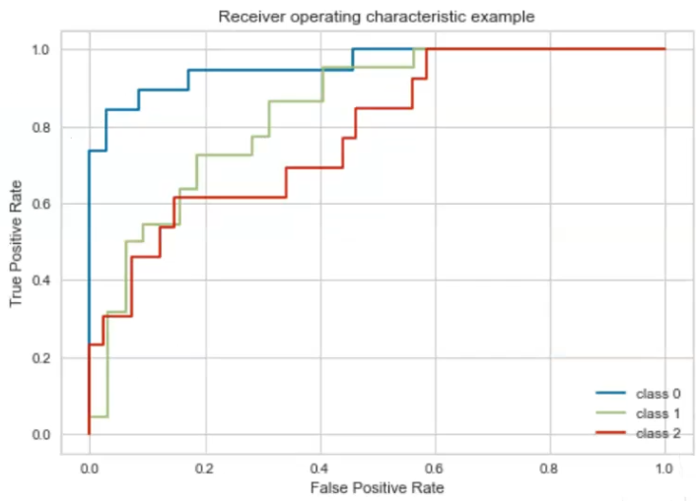
ROC and P-R Curves for Multiclass
Here, we have one curve for every classification.
You can also obtain a unique curve by stacking together the probabilities of each class
This is called a Micro ROC or PR curve

Slide 70
Example
Breast Cancer Dataset from Sklearn
We will apply SVM
We will use all the metrics that we discussed

Slide 71
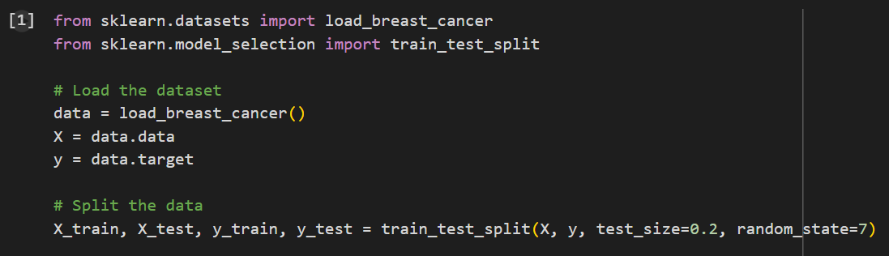
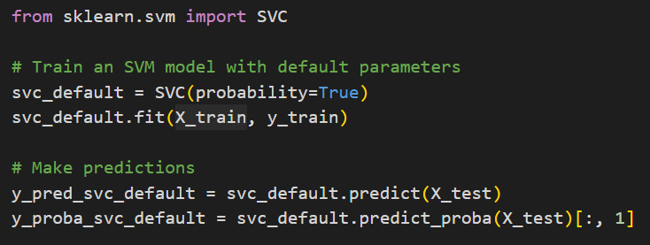
This is probability of class 1 (all rows, second column)
Notes:
By default, the Support Vector Classifier (SVC) in scikit-learn predicts only the class label based on the decision boundary it learns. However, by setting probability=True, the SVC model will also be able to predict probability estimates for each class, meaning it will output the likelihood (or confidence) that a particular sample belongs to each class.

Slide 72
When you set probability=True, after training, the model fits a probabilistic model on top of the SVM's decision function which maps the raw decision scores to probabilities
This will make training slower because we add an additional training step
But we need it for threshold tuning that is required to plot ROC curves or P-R curves
Notes:
By default, the Support Vector Classifier (SVC) in scikit-learn predicts only the class label based on the decision boundary it learns. However, by setting probability=True, the SVC model will also be able to predict probability estimates for each class, meaning it will output the likelihood (or confidence) that a particular sample belongs to each class.

Slide 73
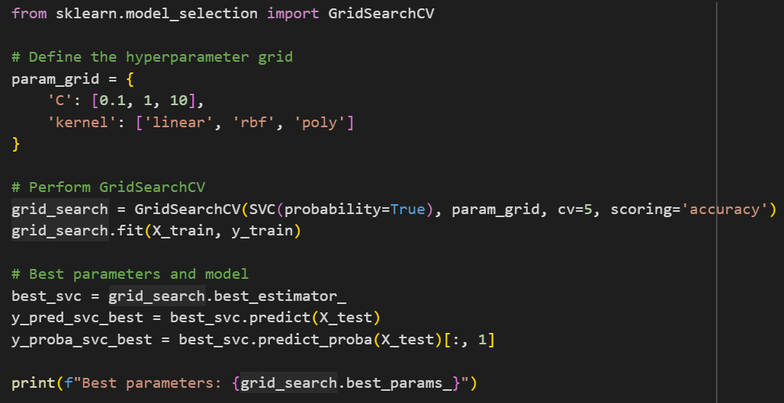
Notes:
cv=5 is 5-fold cross-validation

Slide 74
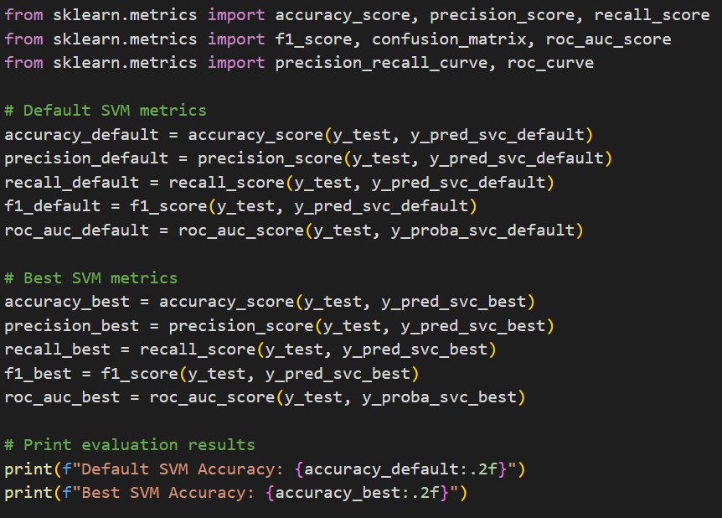
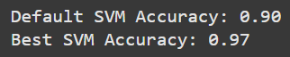

Slide 75
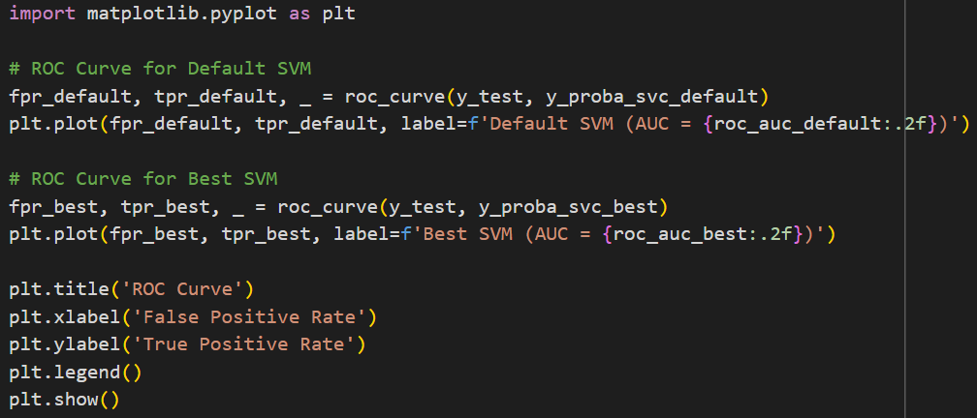
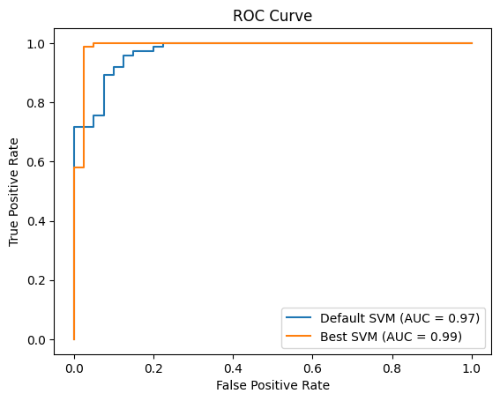

Slide 76
